Slide 1

SJU Scheduling System Database Management
Done by:
Fatemah Alkhalaf Julie Osborne Jumanah Alshehri

Slide 2
Introduction
Build a Database for Saint Joseph’s University
Help Students, Faculty Members, Employees and Perspective Students
Focus on the Computer Science and DSS department.

Slide 3
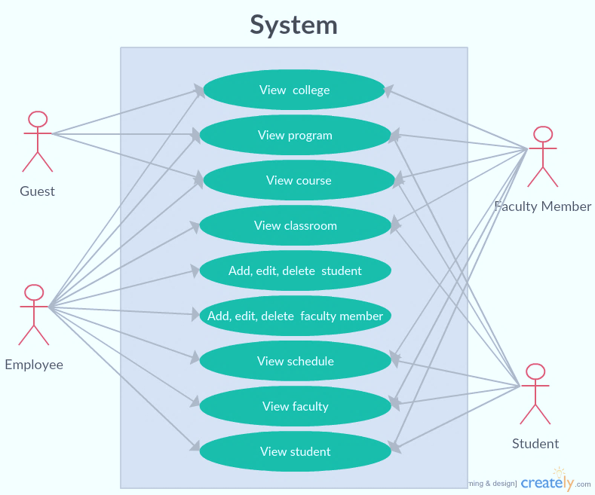
Users

Slide 4
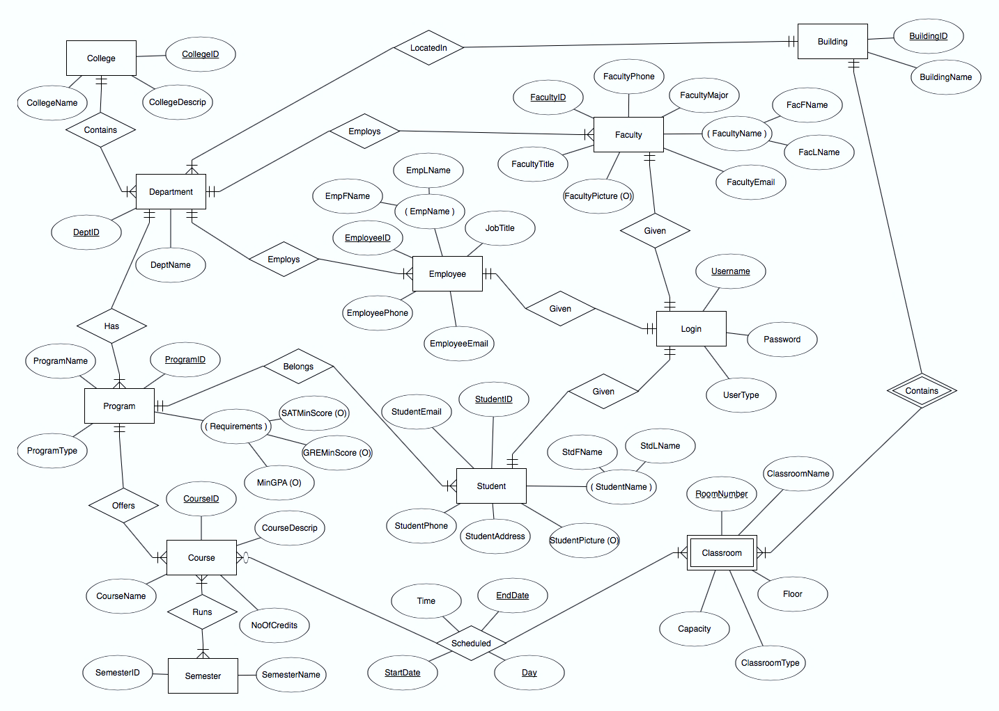
ERD

Slide 5
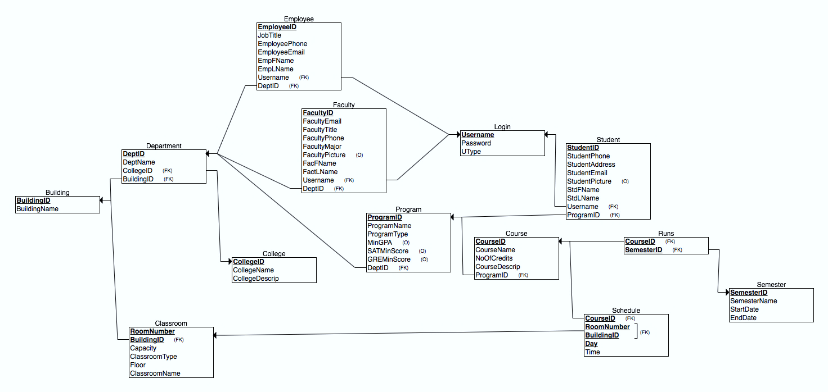
Relational Model

Slide 6
Project Demo …

Slide 7
Challenges
Time
Programming (PHP, AJAX/JQuery, HTML, CSS)
Implementing a real application
Implementing friendly interfaces

Slide 8
Thank you …
Q & A

